Slide 1
5G IA Evaluation Group for IMT-2020
Working Group in 5G PPP
5G IA: https://5g-ia.eu/ 5G PPP: https://5g-ppp.eu/
Evaluation Group: https://5g-ppp.eu/5g-ppp-imt-2020-evaluation-group/

Slide 2












5G Infrastructure Association Independent Evaluation Group for IMT-2020
This Evaluation Group is a Working Group in 5G PPP (Public Private Partnership) under the umbrella of 5G Infrastructure Association (5G IA)
5G PPP is a huge dedicated 5G research program in EU Horizon 2020
Support by 5G PPP projects and 5G IA members
5G PPP Phase II and Phase III projects
5G Infrastructure Association Members
09/12/2019
Source: 5G Infrastructure Association, 5G IA Evaluation Group.

Slide 3
Evaluation process follows ITU-R reports and evaluation guidelines
Interim Evaluation
Report
Final Evaluation
Report
Characteristic for evaluation | High-level assessment method | Evaluation methodology in this report | Related section of Reports ITU-R M.[IMT-2020.TECH PERF REQ] and ITU-R M.[IMT‑2020.SUBMISSION]
Peak data rate | Analytical | § 7.2.2 | Report ITU-R M.[IMT-2020.TECH PERF REQ], § 4.1
Peak spectral efficiency | Analytical | § 7.2.1 | Report ITU-R M.[IMT-2020.TECH PERF REQ], § 4.2
User experienced data rate | Analytical for single band and single layer; Simulation for multi-layer | § 7.2.3 | Report ITU-R M.[IMT-2020.TECH PERF REQ], § 4.3
5th percentile user spectral efficiency | Simulation | § 7.1.2 | Report ITU-R M.[IMT-2020.TECH PERF REQ], § 4.4
Average spectral efficiency | Simulation | § 7.1.1 | Report ITU-R M.[IMT-2020.TECH PERF REQ], § 4.5
Area traffic capacity | Analytical | § 7.2.4 | Report ITU-R M.[IMT-2020.TECH PERF REQ], § 4.6
User plane latency | Analytical | § 7.2.6 | Report ITU-R M.[IMT-2020.TECH PERF REQ], § 4.7.1
Control plane latency | Analytical | § 7.2.5 | Report ITU-R M.[IMT-2020.TECH PERF REQ], § 4.7.2
Connection density | Simulation | § 7.1.3 | Report ITU-R M.[IMT-2020.TECH PERF REQ], § 4.8
Energy efficiency | Inspection | § 7.3.2 | Report ITU-R M.[IMT-2020.TECH PERF REQ], § 4.9
Reliability | Simulation | § 7.1.5 | Report ITU-R M.[IMT-2020.TECH PERF REQ], § 4.10
Mobility | Simulation | § 7.1.4 | Report ITU-R M.[IMT-2020.TECH PERF REQ], § 4.11
Mobility interruption time | Analytical | § 7.2.7 | Report ITU-R M.[IMT-2020.TECH PERF REQ], § 4.12
Bandwidth | Inspection | § 7.3.1 | Report ITU-R M.[IMT-2020.TECH PERF REQ], § 4.13
Support of wide range of services | Inspection | § 7.3.3 | Report ITU-R M.[IMT-2020.SUBMISSION], § 3.1
Supported spectrum band(s)/range(s) | Inspection | § 7.3.4 | Report ITU-R M.[IMT-2020.SUBMISSION], § 3.2
ITU-R report provides detailed guidelines on evaluation methodology and procedures
System simulation procedures
Analytical approach
Inspection approach
Usage scenarios
Test environments
Network layout
Evaluation configurations including detailed parameter settings
Antenna characteristics
Channel models for IMT-2020 for system and link level simulations
NR RIT
LTE
NR RIT
Source: ITU-R WP 5D: Guidelines for evaluation of radio interface technologies for IMT-2020. Report ITU-R M.24.12-0, 11/2017.

Slide 4
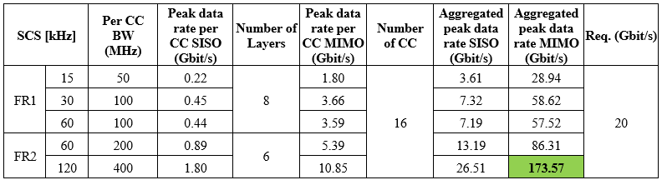
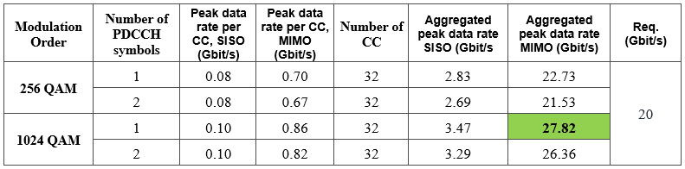
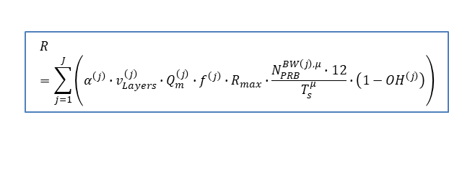
Peak Data Rate
High-level assessment method: Analytical
Minimum requirement: 20 Gbit/s in DL, 10 Gbit/s in UL.
Related section: Report ITU-R M.2410-0, § 4.1
Definition:
5G NR:
DL FDD (FR1): 78,05 Gbit/s
DL TDD (FR1, FR2): 173,57 Gbit/s
UL FDD (FR1): 39,99 Gbit/s
UL TDD (FR1, FR2): 94,57 Gbit/s
4G LTE:
DL FDD: 27,82 Gbit/s
DL TDD: 21,12 Gbit/s
UL FDD: 13,28 Gbit/s
UL TDD: 7,40 Gbit/s
$$R=\sum_{j=1}^{J}{\left(α^{\left(j\right)}∙v_{Layers}^{\left(j\right)}∙Q_{m}^{\left(j\right)}∙f^{\left(j\right)}∙R_{max}∙\frac{N_{PRB}^{BW\left(j\right),μ}∙12}{T_{s}^{μ}}∙\left(1−{OH}^{\left(j\right)}\right)\right)}$$
Examples
09/12/2019
4
Source: 5G Infrastructure Association, 5G IA Evaluation Group.

Slide 5
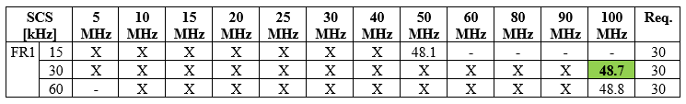
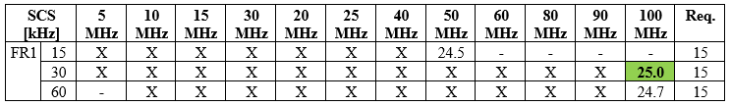
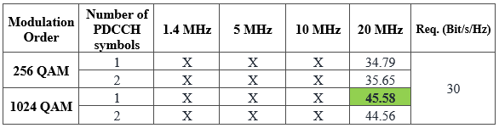


Peak Spectral Efficiency
High-level assessment method: Analytical
Minimum requirement: 30 bit/s/Hz in DL, 15 bit/s/Hz in UL.
Related section: Report ITU-R M.2410-0, § 4.2
Definition:
5G NR:
DL FDD (FR1): 48,8 bit/s/Hz
DL TDD (FR1, FR2): 47,9 bit/s/Hz
UL FDD (FR1): 25 bit/s/Hz
UL TDD (FR1, FR2): 24 bit/s/Hz
4G LTE:
DL FDD: 43,46 bit/s/Hz
DL TDD: 45,58 bit/s/Hz
UL FDD: 20,74 bit/s/Hz
UL TDD: 18,81 bit/s/Hz
$$η_{p}=\frac{γ_{p} }{α^{\left(j\right)}∙BW}$$
Examples
09/12/2019
5
Source: 5G Infrastructure Association, 5G IA Evaluation Group.

Slide 6
User experienced data rate
Dense Urban
Config. A
Evaluation config. | TXRU config. | SCS (kHz) | ITU requirement |  | FDD | TDD
Downlink | 32T4R MU-MIMO | 15 | [Mbit/s] | 100 | 103.37 (@400MHz) | 104.6 (@600MHz)
Uplink | 4T32R SU-MIMO | 15 |  | 50 | 51.0 (@680MHz) | 52.29 (@800MHz)
Config. B in general infeasible due to severe O2I penetration loss in FR 2
Config. C
The uplink user experienced data rate is evaluated using a TDD band (on 30 GHz) and a supplementary uplink (SUL) band (on 4 GHz).
The worst 50% of users on TDD band are offloaded to SUL band.
Transmission scheme and antenna configuration | Sub-carrier spacing | Frame structure | ITU Requirement [Mbps] | Channel model A |  | Channel model B
 |  |  |  | Assumed system bandwidth [MHz] | User exp. data rate [Mbps] | Assumed system bandwidth [MHz] | User exp. data rate [Mbps]
4 GHz (SUL band): 2x32 SU-MIMO; 30 GHz (TDD band): 8x32 SU-MIMO; 50% of users offload to SUL band | 4 GHz: 15kHz 30 GHz: 60kHz | 4 GHz: full uplink; 30 GHz: DDDSU S slot =10DL:2GP:2UL | 50 | 4 GHz: 100 (for UL) 30 GHz: 1200 | 53.1 | 4 GHz: 100 (for UL) 30 GHz: 1200 | 51.4
09/12/2019
6
Source: 5G Infrastructure Association, 5G IA Evaluation Group.

Slide 7
Average spectral efficiency and 5% percentile spectral efficiency
Indoor Hotspot
Config. A DL
Config. A UL
Evaluation config. | TXRU config. | SCS (kHz) | ITU requirement |  | FDD | TDD
12TRxP | 32T4R MU-MIMO | 15 | Average [bit/s/Hz/TRxP] | 9 | 12.14 | 13.62
 |  |  | 5th-tile [bit/s/Hz] | 0.3 | 0.37 | 0.36
36TRxP |  | 15 | Average [bit/s/Hz/TRxP] | 9 | 11.51 | 12.39
 |  |  | 5th-tile [bit/s/Hz] | 0.3 | 0.31 | 0.34
Evaluation config. | TXRU config. | SCS (kHz) | ITU requirement |  | FDD | TDD
12TRxP | 4T32R SU-MIMO | 15 | Average [bit/s/Hz/TRxP] | 6.75 | 8.49 | 8.35
 |  |  | 5th-tile [bit/s/Hz] | 0.21 | 0.48 | 0.49
36TRxP |  | 15 | Average [bit/s/Hz/TRxP] | 6.75 | 7.48 | 7.44
 |  |  | 5th-tile [bit/s/Hz] | 0.21 | 0.28 | 0.31
Config. B DL
Config. B UL
Evaluation config. | TXRU config. | SCS (kHz) | ITU requirement |  | FDD | TDD
12TRxP | 32T4R MU-MIMO | 60 | Average [bit/s/Hz/TRxP] | 9 | 13.06 | 14.67
 |  |  | 5th-tile [bit/s/Hz] | 0.3 | 0.39 | 0.48
36TRxP |  | 60 | Average [bit/s/Hz/TRxP] | 9 | 10.66 | 11.21
 |  |  | 5th-tile [bit/s/Hz] | 0.3 | 0.30 | 0.34
Evaluation config. | TXRU config. | SCS (kHz) | ITU requirement |  | FDD | TDD
12TRxP | 4T32R SU-MIMO | 60 | Average [bit/s/Hz/TRxP] | 6.75 | 7.58 | 7.37
 |  |  | 5th-tile [bit/s/Hz] | 0.21 | 0.41 | 0.40
36TRxP |  | 60 | Average [bit/s/Hz/TRxP] | 6.75 | 6.94 | 7.33
 |  |  | 5th-tile [bit/s/Hz] | 0.21 | 0.31 | 0.23
09/12/2019
7
Source: 5G Infrastructure Association, 5G IA Evaluation Group.

Slide 8
Average spectral efficiency and 5% percentile spectral efficiency
Dense Urban
Config. A DL
Config. A UL
TXRU config. | SCS (kHz) | ITU requirement |  | FDD | TDD
32T4R MU-MIMO | 15 | Average [bit/s/Hz/TRxP] | 7.8 | 12.35 | 13.62
 |  | 5th-tile [bit/s/Hz] | 0.23 | 0.25 | 0.36
TXRU config. | SCS (kHz) | ITU requirement |  | FDD | TDD
4T32R SU-MIMO | 15 | Average [bit/s/Hz/TRxP] | 5.4 | 8.50 | 8.43
 |  | 5th-tile [bit/s/Hz] | 0.15 | 0.30 | 0.25
Config. B in general infeasible due to severe O2I penetration loss in FR 2
09/12/2019
8
Source: 5G Infrastructure Association, 5G IA Evaluation Group.

Slide 9
Area traffic capacity
Indoor Hotspot
Config. A DL
Evaluation config. | TXRU config. | SCS (kHz) | ITU requirement |  | FDD | TDD
12TRxP | 32T4R MU-MIMO | 15 | [Mbit/s/m²] | 10 | 11.77 (@400MHz) | 10.6 (@600MHz)
36TRxP |  | 15 |  |  | 12.04 (@120MHz) | 10.04 (@200MHz)
Config. B DL
Evaluation config. | TXRU config. | SCS (kHz) | ITU requirement |  | FDD | TDD
12TRxP | 32T4R MU-MIMO | 60 | [Mbit/s/m²] | 10 | 12.63 (@400MHz) | 11.41 (@600MHz)
36TRxP |  | 60 |  |  | 15.17 (@200MHz) | 17.43 (@400MHz)
09/12/2019
9
Source: 5G Infrastructure Association, 5G IA Evaluation Group.

Slide 10
Average spectral efficiency and 5% percentile spectral efficiency
Rural
Config. A DL
Config. A UL
TXRU config. | SCS (kHz) | ITU requirement |  | FDD | TDD
8T2R MU-MIMO | 15 | Average [bit/s/Hz/TRxP] | 3.3 | 6.24 | 8.45
 |  | 5th-tile [bit/s/Hz] | 0.12 | 0.19 | 0.21
TXRU config. | SCS (kHz) | ITU requirement |  | FDD | TDD
2T8R SU-MIMO | 15 | Average [bit/s/Hz/TRxP] | 1.6 | 4.1 | 4.74
 |  | 5th-tile [bit/s/Hz] | 0.045 | 0.24 | 0.06
Config. B DL
Config. B UL
TXRU config. | SCS (kHz) | ITU requirement |  | FDD | TDD
32T4R MU-MIMO | 15 | Average [bit/s/Hz/TRxP] | 3.3 | 14.67 | 16.50
 |  | 5th-tile [bit/s/Hz] | 0.12 | 0.25 | 0.23
TXRU config. | SCS (kHz) | ITU requirement |  | FDD | TDD
4T32R SU-MIMO | 15 | Average [bit/s/Hz/TRxP] | 1.6 | 6.88 | 7.01
 |  | 5th-tile [bit/s/Hz] | 0.045 | 0.12 | 0.062
Config. C DL
Config. C UL
TXRU config. | SCS (kHz) | ITU requirement |  | FDD | TDD
8T2R MU-MIMO | 15 | Average [bit/s/Hz/TRxP] | 3.3 | 5.59 | 6.86
 |  | 5th-tile [bit/s/Hz] | 0.12 | 0.13 | 0.13
TXRU config. | SCS (kHz) | ITU requirement |  | FDD | TDD
2T8R SU-MIMO | 15 | Average [bit/s/Hz/TRxP] | 1.6 | 3.59 | 3.42
 |  | 5th-tile [bit/s/Hz] | 0.045 | 0.071 | 0.075
09/12/2019
10
Source: 5G Infrastructure Association, 5G IA Evaluation Group.

Slide 11
Evaluation assumptions for system-level simulation based KPIs (downlink (1/2))
Parameters | Values
Test environment | Indoor Hotspot – eMBB | Dense Urban – eMBB | Rural - eMBB
Evaluation configuration | Configuration A/B | Configuration A | Configuration A/B/C
Channel model | InH_B | UMa_B | RMa_B
ISD | 20 m | 200 m | Configuration A/B: 1732 m; Configuration C: 6000 m
TDD frame structure | DSUUD | DSUUD | DSUUD
Carrier Frequency | Configuration A: 4 GHz Configuration B: 30 GHz | 4 GHz | Configuration A: 700 MHz; Configuration B: 4 GHz Configuration C: 700 MHz
System bandwidth | TDD: Configuration A: 20MHz ;Configuration B: 80MHz | TDD: 20MHz | TDD: 20MHz
 | FDD: 10MHz | FDD: 10MHz | FDD: 10MHz
Subcarrier spacing | configuration A: 15kHz configuration B: 60kHz | 15kHz | 15kHz
Symbols number per slot | 14 | 14 | 14
Number of antenna elements per TRxP | Configuration A/B: 32Tx cross-polarized antennas (M,N,P,Mg,Ng;Mp,Np) = (4,4,2,1,1;4,4); | For 32Tx: 128Tx cross-polarized antennas (M,N,P,Mg,Ng;Mp,Np) = (8,8,2,1,1;2,8) | Configuration A/C: 64Tx cross-polarized antennas (M,N,P,Mg,Ng;Mp,Np) = (8,4,2,1,1;1,4); Configuration B: 128Tx cross-polarized antennas (M,N,P,Mg,Ng;Mp,Np) = (8,8,2,1,1;2,8)
Number of TXRU per TRxP | Configuration A/B: 32TXRU: Vertical 1-to-1 | 32TXRU: Vertical 2-to-8 | Configuration A/C: 8TXRU ,Vertical 1-to-8; Configuration B: 32TXRU Vertical 2-to-8
Number of antenna elements per UE | Configuration A : 4Rx with 0°and 90° polarization Configuration B : 8Rx with 0°,and 90° polarization (M,N,P,Mg,Ng; Mp,Np) = (2,4,2,1,2; 1,2) | 4Rx with 0°and 90° polarization | Configuration A: 2Rx Configuration B/C: 4Rx with 0°and 90° polarization
Transmit power per TRxP | TDD: Configuration A: 24 dBm; Configuration B: 23 dBm | TDD: 44 dBm | TDD: 46 dBm
 | FDD: 21 dBm | FDD: 41 dBm | FDD: 46 dBm
TRxP number per site | 1 or 3 | 3 | 3
Mechanic tilt | 1 TRxP / site: 180deg in GCS (pointing to the ground) 3 TRxP / site: 110 deg in GCS | 90deg in GCS (pointing to the horizontal direction) | 90deg in GCS (pointing to the horizontal direction)
Electronic tilt | Configuration A: 90deg in LCS Configuration B: According to Zenith angle in "Beam set at TRxP" | 105deg in LCS | Configuration A/B: 100deg in LCS Configuration C: 92deg in LCS
Beam set at TRxP | Configuration B: Azimuth angle φi = [0], Zenith angle θj = [pi/2] | N/A | N/A
Beam set at UE | Configuration B: Azimuth angle φi = [-pi/4, pi/4]; Zenith angle θj = [pi/4, 3*pi/4] | N/A | N/A
UT attachment | Based on RSRP (Eq. (8.1-1) in TR 36.873) from port 0 | Based on RSRP (Eq. (8.1-1) in TR 36.873) from port 0 | Based on RSRP (Eq. (8.1-1) in TR 36.873) from port 0
09/12/2019
11
Source: 5G Infrastructure Association, 5G IA Evaluation Group.

Slide 12
Evaluation assumptions for system-level simulation based KPIs (downlink (2/2))
Parameters |  | Values
Test environment |  | Indoor Hotspot – eMBB | Dense Urban – eMBB | Rural - eMBB
Scheduling |  | MU-PF | MU-PF | MU-PF
MIMO mode |  | MU-MIMO with rank 1-2 adaptation per user; Configuration A: Maximum MU layer = 12; Configuration B: Maximum MU layer = 6 | MU-MIMO with rank 1-2 adaptation per user; Maximum MU layer = 12 | MU-MIMO with rank 1-2 adaptation per user; Maximum MU layer = 8 for 8Tx and maximum MU layer = 12 for 32Tx;
Guard band ratio |  | TDD: Configuration A: 8.2% for 30kHz SCS and 4.6% for 15kHz SCS (for 20 MHz); Configuration B: 5.5% (for 80 MHz); | TDD: 8.2% for 30kHz SCS and 4.6% for 15kHz SCS (for 20 MHz) | 8.2% for 30kHz SCS and 4.6% for 15kHz SCS (for 20 MHz)
 |  | FDD: 6.4% (for 10 MHz) | FDD: 6.4% (for 10 MHz) | FDD: 6.4% (for 10 MHz)
BS receiver type |  | MMSE-IRC | MMSE-IRC | MMSE-IRC
CSI feedback |  | 5 slots period based on non-precoded CSI-RS with delay | For 32Tx: 5 slots period based on non-precoded CSI-RS with delay; | 5 slots period based on non-precoded CSI-RS with delay
SRS transmission |  | Precoded SRS for 2Tx ports; Period: 5 slots; 2 symbols | Precoded SRS for 2Tx ports; Period: 5 slots; 2 symbols | Precoded SRS for 2Tx ports; Period: 5 slots; 2 symbols
Precoder derivation |  | TDD: SRS based | TDD: SRS based | TDD: SRS based
 |  | FDD: NR Type II codebook (4 beams, WB+SB quantization, 8 PSK) | FDD: NR Type II codebook (4 beams, WB+SB quantization, 8 PSK) | FDD: NR Type II codebook (4 beams, WB+SB quantization, 8 PSK)
Overhead | PDCCH | 2 complete symbols | 2 complete symbols | 2 complete symbols
 | DMRS | Type II, based on MU-layer (dynamic in simulation) | Type II, based on MU-layer (dynamic in simulation) | Type II, based on MU-layer (dynamic in simulation)
 | CSI-RS | FDD: 32 ports per 5 slots | FDD: 32 ports per 5 slots | FDD: 8/16/32 ports for 8Tx/16Tx/32Tx
 |  | TDD: 32 ports per 5 slots | TDD: For 64Tx, 4 ports per UE per 5 slots; For 32Tx, 32 ports per 5 slots | TDD: 8/16/32 ports for 8Tx/16Tx/32Tx
 | CSI-RS for IM | ZP CSI-RS with 5 slots period; 4 RE/PRB/5 slots | ZP CSI-RS with 5 slots period; 4 RE/PRB/5 slots | ZP CSI-RS with 5 slots period; 4 RE/PRB/5 slots
 | SSB | 1 SSB per 10 ms | 1 SSB per 10 ms | 1 SSB per 10 ms
 | TRS | 2 consecutive slots per 20 ms, 1 port, maximal 52 PRBs | 2 consecutive slots per 20ms, 1 port, maximal 52 PRBs | 2 consecutive slots per 20 ms, 1 port, maximal 52 PRBs
 | PTRS | Configuration B: 2 ports PT-RS, (L,K) = (1,4) L is time domain density and K is frequency domain density | N/A | N/A
Channel estimation |  | Non-ideal | Non-ideal | Non-ideal
Waveform |  | OFDM | OFDM | OFDM
09/12/2019
12
Source: 5G Infrastructure Association, 5G IA Evaluation Group.

Slide 13
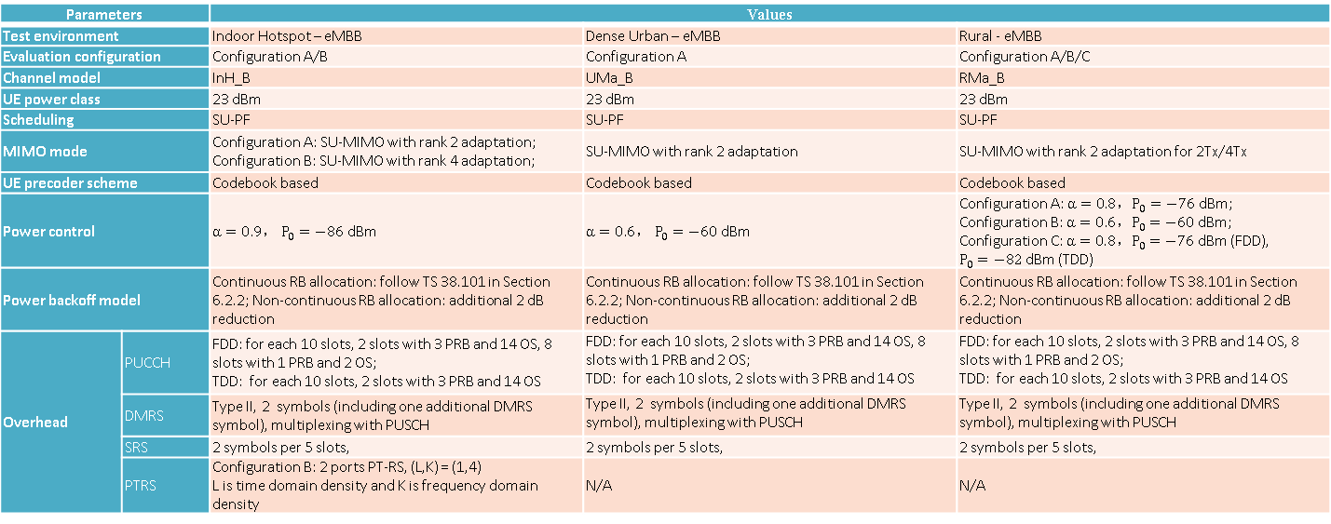
Additional evaluation assumptions for
system-level simulation based KPIs (uplink)
Parameters |  | Values
Test environment |  | Indoor Hotspot – eMBB | Dense Urban – eMBB | Rural - eMBB
Evaluation configuration |  | Configuration A/B | Configuration A | Configuration A/B/C
Channel model |  | InH_B | UMa_B | RMa_B
UE power class |  | 23 dBm | 23 dBm | 23 dBm
Scheduling |  | SU-PF | SU-PF | SU-PF
MIMO mode |  | Configuration A: SU-MIMO with rank 2 adaptation; Configuration B: SU-MIMO with rank 4 adaptation; | SU-MIMO with rank 2 adaptation | SU-MIMO with rank 2 adaptation for 2Tx/4Tx
UE precoder scheme |  | Codebook based | Codebook based | Codebook based
Power control |  | $α=0.9， P_{0}=−86$ dBm | $α=0.6， P_{0}=−60$ dBm | Configuration A: $α=0.8，P_{0}=−76$ dBm; Configuration B: $α=0.6，P_{0}=−60$ dBm; Configuration C: $α=0.8，P_{0}=−76$ dBm (FDD), $P_{0}=−82$ dBm (TDD)
Power backoff model |  | Continuous RB allocation: follow TS 38.101 in Section 6.2.2; Non-continuous RB allocation: additional 2 dB reduction | Continuous RB allocation: follow TS 38.101 in Section 6.2.2; Non-continuous RB allocation: additional 2 dB reduction | Continuous RB allocation: follow TS 38.101 in Section 6.2.2; Non-continuous RB allocation: additional 2 dB reduction
Overhead | PUCCH | FDD: for each 10 slots, 2 slots with 3 PRB and 14 OS, 8 slots with 1 PRB and 2 OS; TDD: for each 10 slots, 2 slots with 3 PRB and 14 OS | FDD: for each 10 slots, 2 slots with 3 PRB and 14 OS, 8 slots with 1 PRB and 2 OS; TDD: for each 10 slots, 2 slots with 3 PRB and 14 OS | FDD: for each 10 slots, 2 slots with 3 PRB and 14 OS, 8 slots with 1 PRB and 2 OS; TDD: for each 10 slots, 2 slots with 3 PRB and 14 OS
 | DMRS | Type II, 2 symbols (including one additional DMRS symbol), multiplexing with PUSCH | Type II, 2 symbols (including one additional DMRS symbol), multiplexing with PUSCH | Type II, 2 symbols (including one additional DMRS symbol), multiplexing with PUSCH
 | SRS | 2 symbols per 5 slots, | 2 symbols per 5 slots, | 2 symbols per 5 slots,
 | PTRS | Configuration B: 2 ports PT-RS, (L,K) = (1,4) L is time domain density and K is frequency domain density | N/A | N/A
09/12/2019
13
Source: 5G Infrastructure Association, 5G IA Evaluation Group.

Slide 14
Evaluation assumptions for uplink user experience data rate, Configuration C
Parameters |  | Values
Test environment |  | Dense Urban -eMBB
Carrier frequency for evaluation |  | 4GHz for SUL band | 30 GHz for TDD band (TDD: DDDSU)
Simulation bandwidth |  | FDD:10MHz | TDD: 80MHz
Subcarrier spacing |  | 15 kHz for 4GHz | 60kHz for 30GHz
Symbols number per slot |  | 14
Channel model |  | Channel model A/Channel model B
Number of antenna elements per TRxP |  | 128Tx/Rx with cross-polarized antennas (M,N,P,Mg,Ng) = (8,8,2,1,1), (dH,dV) = (0.5, 0.5)λ | 256Tx/Rx with cross-polarized antennas (M,N,P,Mg,Ng) = (4,8,2,2,2), (dH,dV) = (0.5, 0.5)λ. (dg,H,dg,V) = (4.0, 2.0)λ
Number of TXRU per TRxP |  | 32TXRU, (Mp,Np,P,Mg,Ng) =(2,8,2,1,1) | 32TXRU, (Mp,Np,P,Mg,Ng) =(1,4,2,2,2)
Number of UE antenna elements |  | 2Tx/Rx with 0°and 90° polarization, (M,N,P,Mg,Ng) = (1,1,2,1,1), (dH,dV) = (0.5, 0.5)λ | 32Tx/Rx with 0°and 90° polarization, (M,N,P,Mg,Ng) = (2,4 ,2,1,2), (dH,dV) = (0.5, 0.5)λ (dg,V,dg,H) = (0, 0)λ. Θmg,ng=90; Ω0,1=Ω0,0+180;
Number of TXRU per UE |  | 2TXRU, (Mp,Np,P,Mg,Ng) = (1,1,2,1,1) (1-to-1 mapping) | 8TXRU, (Mp,Np,P,Mg,Ng)=(1,2,2,1,2) , 1 panel Tx
UE power class |  | 23 dBm
Mechanic tilt |  | 90° in GCS (pointing to horizontal direction)
Electronic tilt |  | 105deg in LCS | (According to Zenith angle in "Beam set at TRxP")
UT attachment |  | Based on RSRP (formula) from CRS port 0. For SUL+TDD evaluation, The UE selects the cell with maximum RSRP on 30GHz as the serving cell; If RSRP is lower than a threshold (-106dBm), the UE will select 4GHz (assumed as SUL band) for UL transmission. For this threshold value, around 50% of UEs select 4 GHz for UL transmission.
Beam set at TRxP for 30 GHz |  | - | Azimuth angle φ_{i} = [-pi/4, pi/4], Zenith angle θ_{j} = 7*pi/12;
Beam set at UE for 30 GHz |  | - | Azimuth angle φ_{i} = [-pi/4, pi/4], Zenith angle θ_{j} = [pi/4, 3*pi/4];
Power backoff model |  | Continuous RB allocation: follow TS 38.101 in Section 6.2.2; Non-continuous RB allocation: additional 2 dB reduction
Guard band ratio |  | 6.4% for 10MHz bandwidth | 5.5% for 80MHz bandwidth
Overhead | PUCCH | For each 10 slots, 2 slots with 3 PRB and 14 OS, 8 slots with 1 PRB and 2 OS | For each 10 slots, 2 slots with 3 PRB and 14 OS
 | DMRS | Type II, 2 symbols (including one additional DMRS symbol), multiplexing with PUSCH | Type II, 2 symbols (including one additional DMRS symbol), multiplexing with PUSCH
 | SRS | 2 symbols per 5 slots | 2 symbols per 5 slots
 | PTRS | N/A | Configuration B: 2 ports PT-RS, (L,K) = (1,4) L is time domain density and K is frequency domain density
Scheduler |  | SU-PF
MIMO mode |  | SU-MIMO with rank 2 adaptation per user
Channel estimation |  | Non-ideal
BS receiver type |  | MMSE-IRC
UE precoder scheme |  | Codebook based
UL CSI derivation |  | Non-precoded SRS based with delay
09/12/2019
14
Source: 5G Infrastructure Association, 5G IA Evaluation Group.

Slide 15
User plane latency
Results will be provided in the final Evaluation Report
Work in progress
09/12/2019
15
Source: 5G Infrastructure Association, 5G IA Evaluation Group.

Slide 16
Control plane latency
Evaluation method: Analytical
Minimum requirement: 20 ms (mandatory), lower values are desirable, e.g. 10 ms
Related section: Report ITU-R M.2410-0, § 4.7.2
Definition: Control plane latency refers to the transition time from a most “battery efficient” state (e.g. Idle state) to the start of continuous data transfer (e.g. Active state)
Assumptions
dmrs-AdditionalPosition = pos0
Type A PDSCH. Starting OFDM symbol S = 0,1 or 2
Type B PDSCH: S can be any of the first 12 OFDM symbols
delay for RACH scheduling period is 0 ms (Step 1)
gNB processing delay in Step 7 equals 3 ms although not specified in 3GPP standards
Analytical Calculations performed for all configurations (non-slot length and sub-carrier spacings) provided in TR 37.910
UE
C-Plane Procedure
gNB
1. Delay for RACH Scheduling Period
2. RACH Preamble
3. Processing delay in gNB
5. Processing delay in UE
4. RA response
6. RRC Resume Request
Control plane procedure
7. Processing delay in gNB
8. RRC Resume
Conclusions
NR FDD: calculated CP latency was below 20 ms for all cases; minimum latency approaches 11 ms for configurations with 120 kHz subcarrier spacing
NR TDD: below 20 ms for all cases; deviation from 3GPP calculations exist for some configurations; evaluation is in progress
9. Processing delay in UE
10. RRC Resume Complete
09/12/2019
16
Source: 5G Infrastructure Association, 5G IA Evaluation Group.

Slide 17
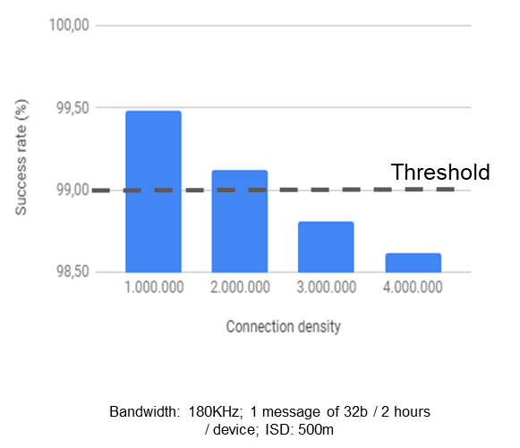
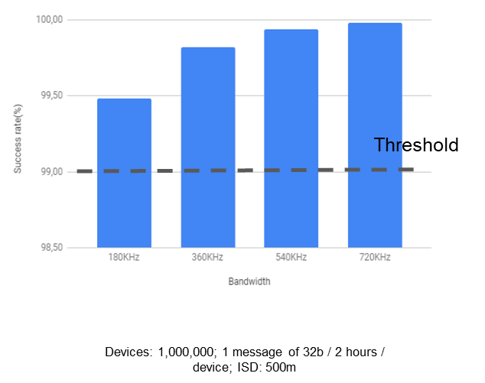
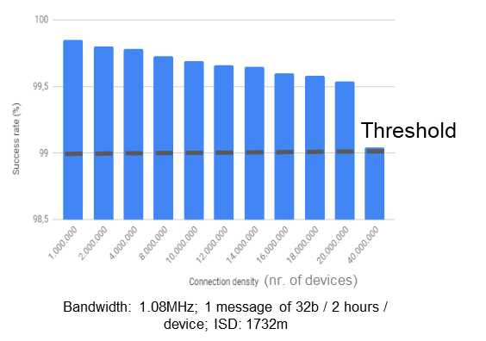
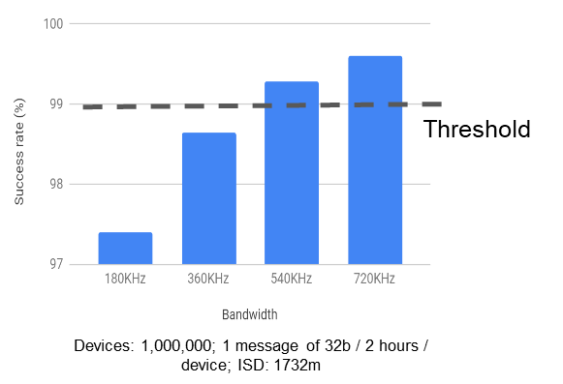
Connection density
99%
99%
Success rate vs. Connection density (nr. of devices per km²) for ISD 500m
Success rate vs. bandwidth (for ISD 500m)
99%
99%
Success rate vs. Connection density (nr. of devices per km²) for ISD 1732m
Success rate vs. bandwidth (for ISD 1732m)
The ITU-R minimum requirement is fulfilled
09/12/2019
17
Source: 5G Infrastructure Association, 5G IA Evaluation Group.

Slide 18
Energy efficiency
Only the unloaded case is evaluated; the loaded case is covered by the evaluation of the average spectral efficiency.
Technical concepts to improve energy efficiency for 5G NR:
Network energy efficiency when there is no data
High fraction of unoccupied resources (sleep ratio up to 99.87% and sleep duration up to 159 ms)
Device energy efficiency when there is no data
Discontinuous reception (DRX) in RRC_CONNECTED, RRC_INACTIVE and RRC_IDLE (sleep ratio up to 99.5% and sleep duration up to 10.24 s)
Bandwidth part (BWP) adaptation
Introduction of the RRC_INACTIVE state
Technical concepts to improve energy efficiency for LTE Rel-15:
Network energy efficiency when there is no data
Switching off capacity boosting cells
Device energy efficiency when there is no data
Discontinuous reception (DRX) in RRC connected mode
Discontinuous reception (DRX) in RRC idle mode
Extended discontinuous reception (DRX) in RRC idle mode
Paging with wake-up signal in idle mode
Power saving mode operation in idle mode (PSM)
Both NR and LTE support high sleep ratios and long sleep durations
Conclusion: Both NR and LTE meet the energy efficiency requirements
09/12/2019
18
Source: 5G Infrastructure Association, 5G IA Evaluation Group.

Slide 19
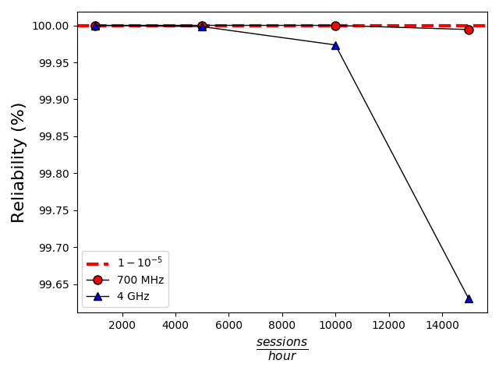
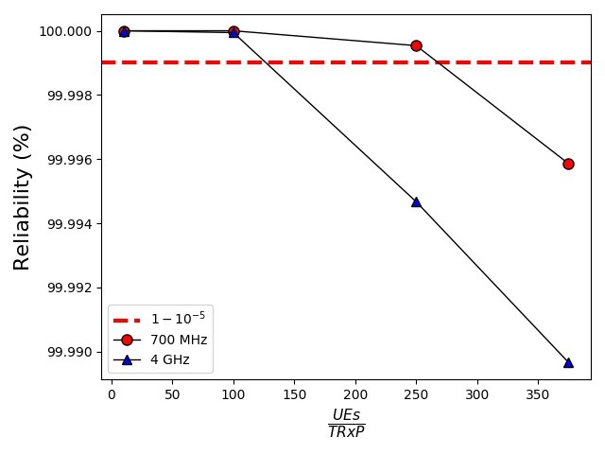
Reliability
M
B
Threshold: 99.999%
 | Value
Inter-site distance | 500 m
Macro BSs (3 TRxP each) | 3
Bandwidth (MHz) | 10
Packet size (bytes) | 50
 | UE density | Session period
Scenario 1 | 10 UEs/TRxP | variable
Scenario 2 | variable | 1000 sessions/hour/UE
1000
DL
Reliability vs. variable session periods
Threshold: 99.999%
The ITU-R minimum requirement is fulfilled
10
09/12/2019
19
Reliability vs. variable UE densities
Source: 5G Infrastructure Association, 5G IA Evaluation Group.
Evaluation configuration | Antenna configuration | Sub-carrier spacing [kHz] | ITU Requirement | Channel model A |  | Channel model B
 |  |  |  | Channel condition | Reliability | Channel condition | Reliability
Evaluation configuration A | 1T8R | 60 | 99.999% | NLOS | 99.999995% | NLOS | 99.9999997%
Evaluation configuration B | 1T16R | 60 |  | NLOS | 99.99989% | NLOS | 99.999992%
UL

Slide 20
Mobility
Test environment | ITU requirement (bit/s/Hz) | Evaluation configuration | Channel Model | 50%-ile point of SINR CDF (dB) | Uplink SE (bit/s/Hz)
 |  |  |  |  | FDD |  | TDD
 |  |  |  |  | NLOS | LOS | NLOS | LOS
Indoor Hotspot –eMBB (12 TRxP) | 1.5 | Config. A (4 GHz) | Channel model A | 3.90 | 1.75 | 2.05 | 1.59 | 1.94
 |  |  | Channel model B | 3.95 | 1.75 | 2.07 | 1.60 | 1.95
Dense Urban – eMBB | 1.12 | Config. A (4 GHz) | Channel model A | 5.52 | 1.92 | 2.22 | 1.82 | 2.17
 |  |  | Channel model B | 5.32 | 1.89 | 2.19 | 1.79 | 2.06
Rural –eMBB (120 km/h) | 0.8 | Config. A (700 MHz) | Channel model A | 10.21 | 2.32 | 2.90 | 2.10 | 2.63
 |  |  | Channel model B | 10.14 | 2.31 | 2.90 | 2.09 | 2.63
 |  | Config. B (4 GHz) | Channel model A | 4.66 | 1.30 | 1.74 | 1.18 | 1.57
 |  |  | Channel model B | 4.50 | 1.28 | 1.68 | 1.16 | 1.52
Rural –eMBB (500 km/h) | 0.45 | Config. A (700 MHz) | Channel model A | 9.67 | 2.07 | 2.64 | 1.88 | 2.39
 |  |  | Channel model B | 9.65 | 2.07 | 2.64 | 1.87 | 2.39
 |  | Config. B (4 GHz) | Channel model A | 2.90 | 0.92 | 1.33 | 0.84 | 1.22
 |  |  | Channel model B | 2.72 | 0.91 | 1.33 | 0.83 | 1.22
The ITU-R minimum requirement is fulfilled
09/12/2019
20
Source: 5G Infrastructure Association, 5G IA Evaluation Group.

Slide 21
Mobility interruption time (MIT)
Minimum ITU-R requirement on mobility interruption time (MIT) is 0 ms
MIT in NR and LTE | Proposed means to minimize MIT
There is a handover preparation step and a handover execution step in the RAN network between the source and target. During the handover execution procedure Source forwards user plane data to the target using the Xn interface in NR. A number of messaging steps occur between CN functions to modify the user plane data path for the user. | Two principles applied Dual connectivity: before the handover procedure starts, Dual Connectivity in the master base station (MeNB) will be configured and a secondary base station (SeNB) will be added to the UE. Make-before-break Handover: Source link is not released until the additional SeNB is fully operational.
Conclusion: Using proposed means like “Make-before-break Handover” and dual connectivity to MIT can ensure that the minimum ITU-R requirement of 0 ms
09/12/2019
21
Source: 5G Infrastructure Association, 5G IA Evaluation Group.

Slide 22
Bandwidth
Minimum ITU-R requirements for SRIT and NR RIT
Bandwidth is maximum aggregated system bandwidth
At least 100 MHz below 6 GHz carrier frequency
Up to 1 GHz above 6 GHz carrier frequency
Minimum requirements fulfilled
ITU-R requirements | NR component RIT | LTE component RIT
Below 6 GHz | One component carrier: Scalable bandwidth, 5, 10, 15, 20, 25, 40, 50, 60, 80, 100 MHz Aggregating multiple component carriers: Bandwidths up to 6.4 GHz | One component carrier Scalable bandwidth, 1.4, 3, 5, 10, 15 and 20 MHz Aggregating multiple component carrier: Bandwidths up to 640 MHz
Above 6 GHz | One component carrier: Scalable bandwidth, 5, 10, 15, 20, 25, 40, 50, 60, 80, 100 MHz Aggregating multiple component carrier:, Bandwidths up to 6.4 GHz | No higher frequency bands above 6 GHz supported
09/12/2019
22
Source: 5G Infrastructure Association, 5G IA Evaluation Group.

Slide 23
Support of wide range of services
Results will be provided in the final Evaluation Report
Work in progress
09/12/2019
23
Source: 5G Infrastructure Association, 5G IA Evaluation Group.

Slide 24
Supported spectrum bands
Minimum ITU-R requirements for SRIT and NR RIT
Minimum requirements fulfilled by combination of NR and LTE RIT
ITU-R requirements | NR component RIT | LTE component RIT
450-470 MHz | Not supported | Supported
470-698 MHz | Not supported | Supported
694/698-960 MHz | Supported | Supported
1 427-1 518 MHz | Supported | Supported
1 710-2 025 MHz | Supported | Supported
2 110-2 200 MHz | Supported | Supported
2 300-2 400 MHz | Supported | Supported
2 500-2 690 MHz | Supported | Supported
3 300-3 400 MHz | Supported | Supported
3 400-3 600 MHz | Supported | Supported
3600-3700 MHz | Supported | Supported
4 800-4 990 MHz | Supported | Supported
Higher frequency bands are subject of WRC 2019 | Supported | Not supported
09/12/2019
24
Source: 5G Infrastructure Association, 5G IA Evaluation Group.

Slide 25
http://5g-ppp.eu
Thank you for your attention!

